Slide 1
Rental Car Growth Strategy
By Darlene Cooper, Financial Analyst, 11/21/2019
Notes:
Hello everyone,
I am Darlene Cooper, your Sr. HR Analyst and Presenter today.
Welcome to the review of the financial resources review based on 4 strategies that were developed from the data of the last year.

Slide 2
Contents
Fiscal Year 2018 Review versus Strategies
Strategy I
Strategy II
Strategy III
Strategy (Combined)
2019 Recommendations
Notes:
In the presentation today, we are going to cover
The 2018 Fiscal Review
Strategies 1 – 4
2019 Recommendations
We will have a section for questions and answers
Let’s begin…

Slide 3
Fiscal Year 2018 Review
Notes:
FY 2019 Rental Revenue Planning
Here is the summary of the financial strategies in contrast with 2018.
The purpose of this model is to optimize rental revenue to increase and decrease costs.
In the following slides we will review a detailed breakdown of the strategies in the model to give you a clear outline of considerations to be made with each strategy.

Slide 4
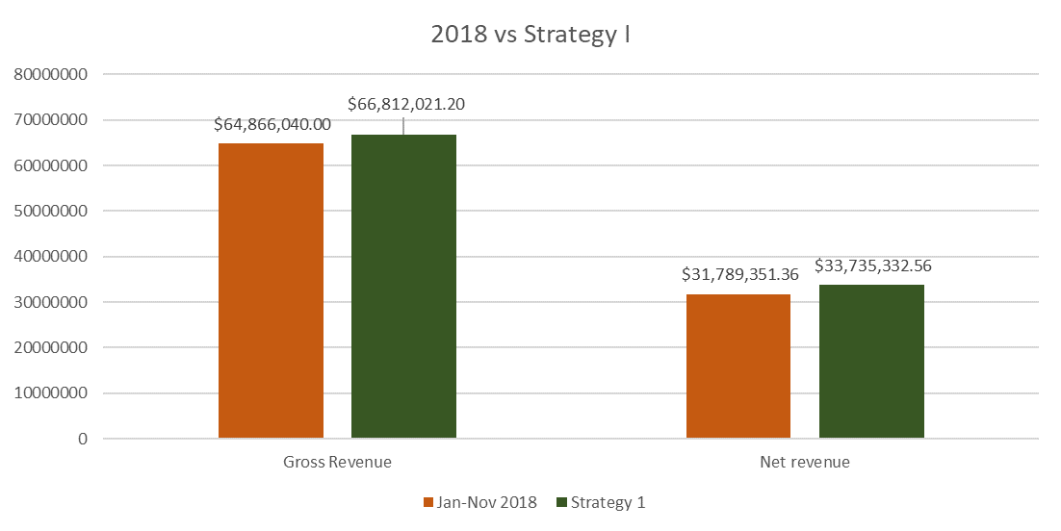
Strategy I
Notes:
Strategy 1 - Assuming there is an increase of $3-$5 on the daily rate for each car which is approximately a 30% growth rate.

Slide 5
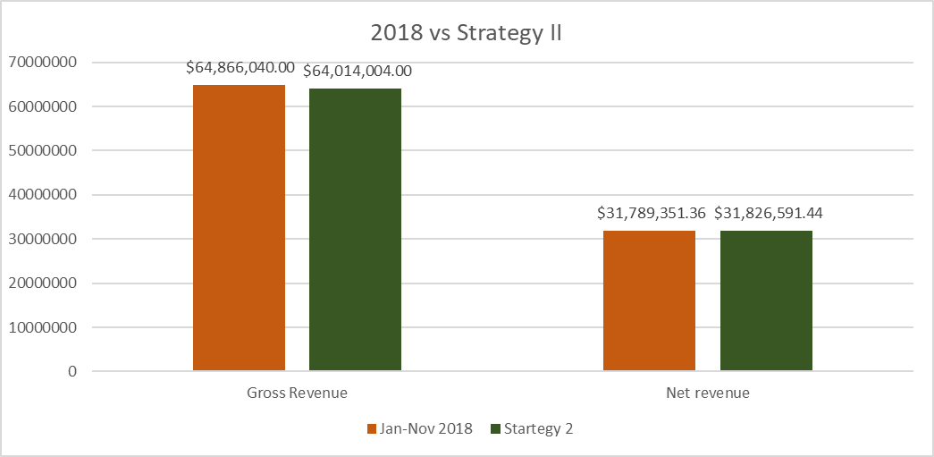
Strategy II
Notes:
Strategy 2 - Looking at the cars that bring in the least revenue in comparison to the cost of the car. Replacing those cars with the cars that have the most return on revenue versus cost.

Slide 6
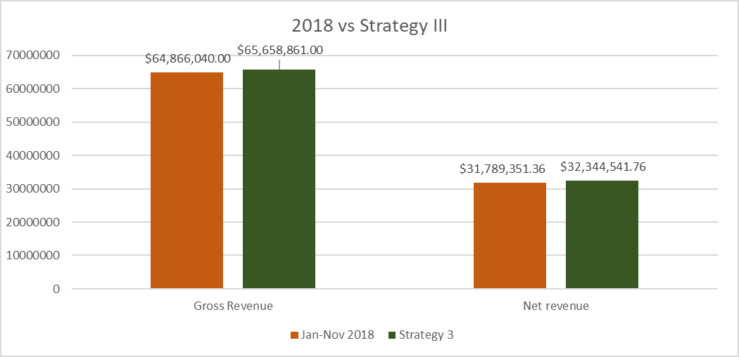
Strategy III
Notes:
Strategy 3 - Closing branches that are bringing in less revenue. Adding the cars from the closed branches that have a positive return in revenue to the active branches. Duplicate cars that are in high return.

Slide 7
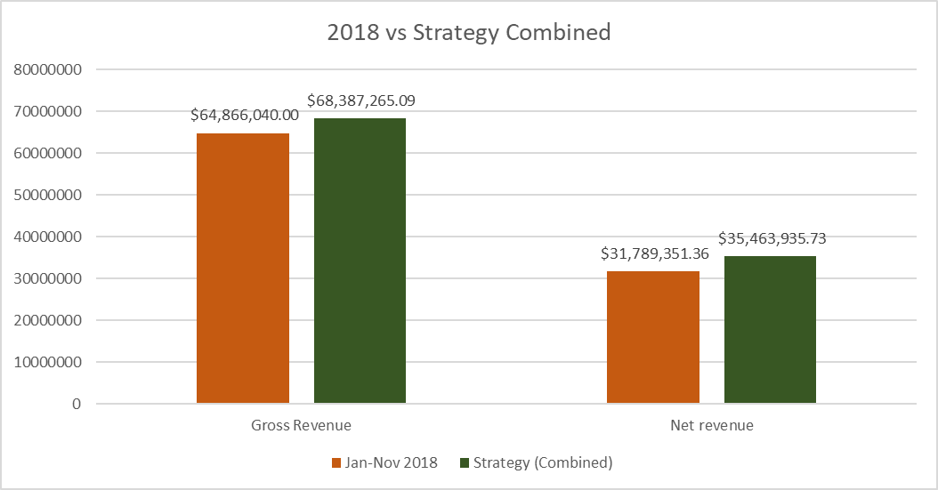
Strategy IV (Combined)
Notes:
Main Goal: Combine 3 strategies (modifying prices, amount of car types, and reduce the cost of the monthly costs to increase revenue for 2019)
In reviewing the strategies which one sounds more feasible and meets our goals and expectations?
From my analysis I believe getting on the right track is choosing the combined strategy. It holds three of the strategies into consideration meeting the goals of increasing the revenue by $3.6M and reducing costs over $150K.

Slide 8
Questions ?
Notes:
Questions?
Comments?
What am I missing?
Did I meet or exceed your expectations or concerns?

Slide 9
Thank You
Notes:
Thank you for your time and listening to my recommendations. Please feel free to reach out to me via email if you need any further support regarding the decision-making process. Have a great day.

